Slide 1
Data Science for Linguistics Understanding the Role of Verbs in the Context of Gerunds.
Members: Satvik, Akash, Sreyoshi, Nanda, Divya, Suhasini
Advisor: Scott Grimm

Slide 2
Overview
DATA DESCRIPTION
METHODOLOGY
VERBNET
GRAPHS

Slide 3
Data Description
Number of Rows: 55059 -> Sentences, Gerunds, Position of Gerunds.
Total Number of Verbs (including Gerunds): 155501
Total Number of Unique Verbs (including Gerunds): 6503
Total Number of Unique Gerunds: 4271
The (mean, median, mode) length of a sentence in the data-frame is: (32.57, 30.0, 26).
The (mean, median) gerund position in a sentence is: (16.8, 14.0). [SD: 12.7 Range: 165]

Slide 4
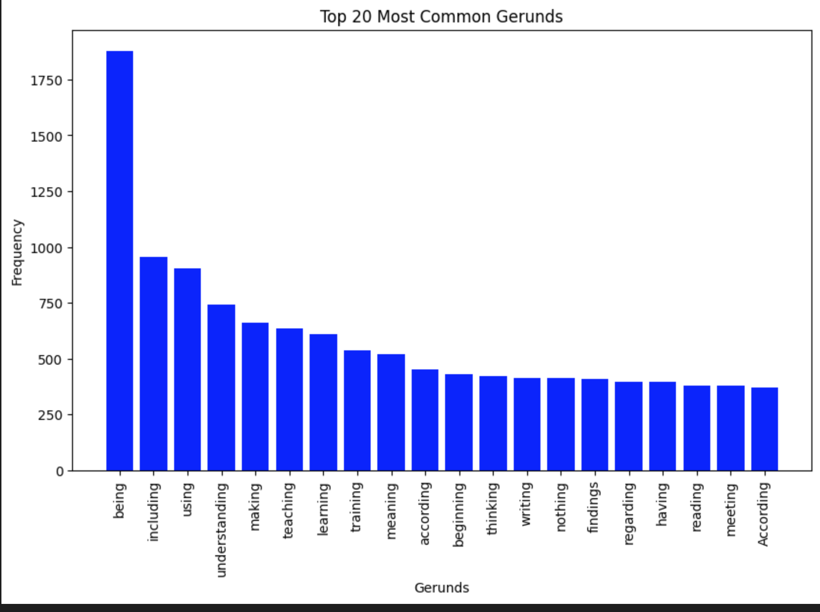
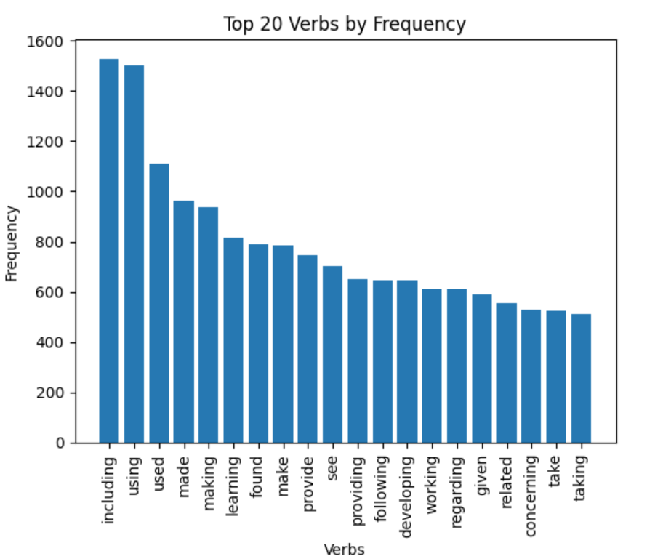
Data Description

Slide 5
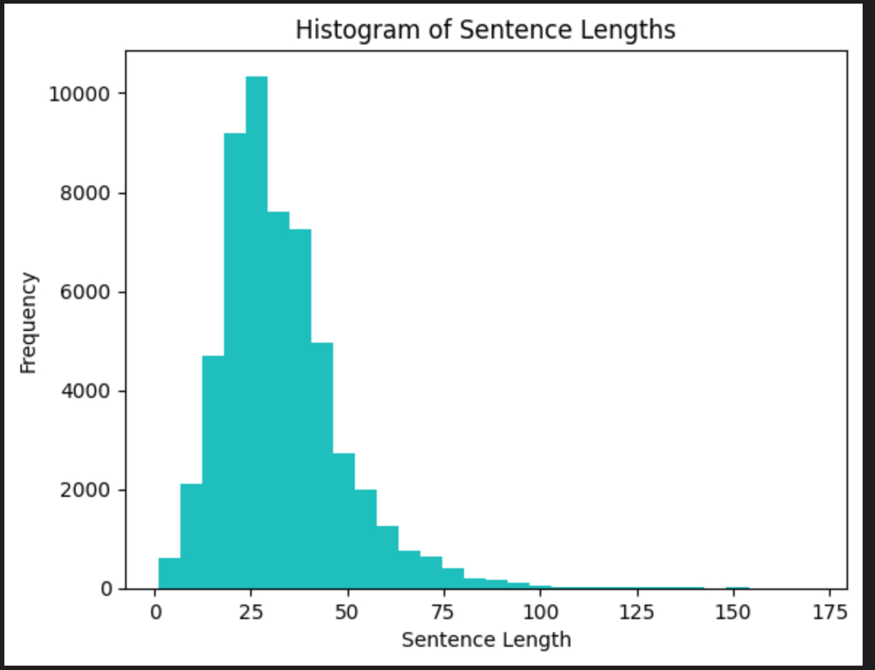
Data Description

Slide 6
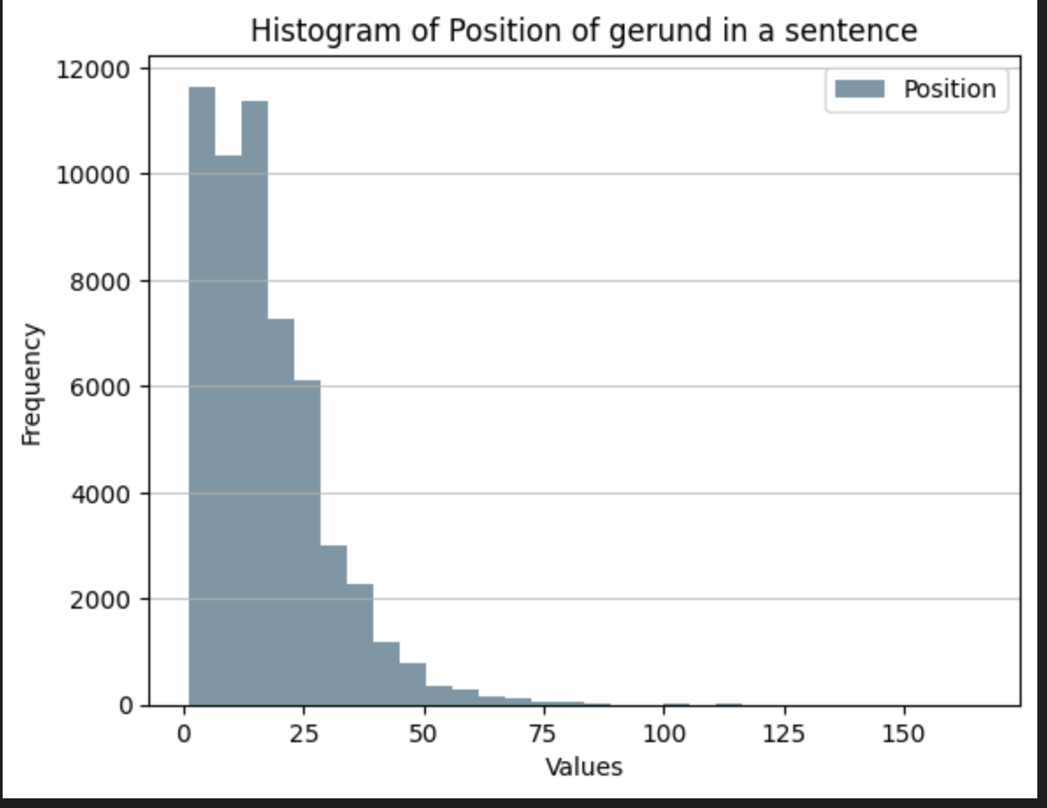
Data Description

Slide 7
Methodology
Co-occurrence between gerunds and verbs
Co-occurrence between gerund types and verbs types (from verbnet)
Co-occurrence between gerund and verb types (from verbnet)
Co-occurrence between the position of verbs w.r.t gerund and verb types (from verbnet)

Slide 8
Methodology- Co-occurrence between gerunds and verbs
_verbs = ['remember’, 'feeling’, 'victimizing’, 'drawing']
gerund = 'feeling’
sentences = ["I remember and victimizing feeling and remember victimizing happy.", "She was remember feeling sick.", "He was victimizing her by making her feel guilty.", "She was drawing and feeling relaxed."]
Co-occurrences of gerund - 'feeling' with each verb:
remember: 2
feeling: 0
victimizing: 1
drawing: 1

Slide 9
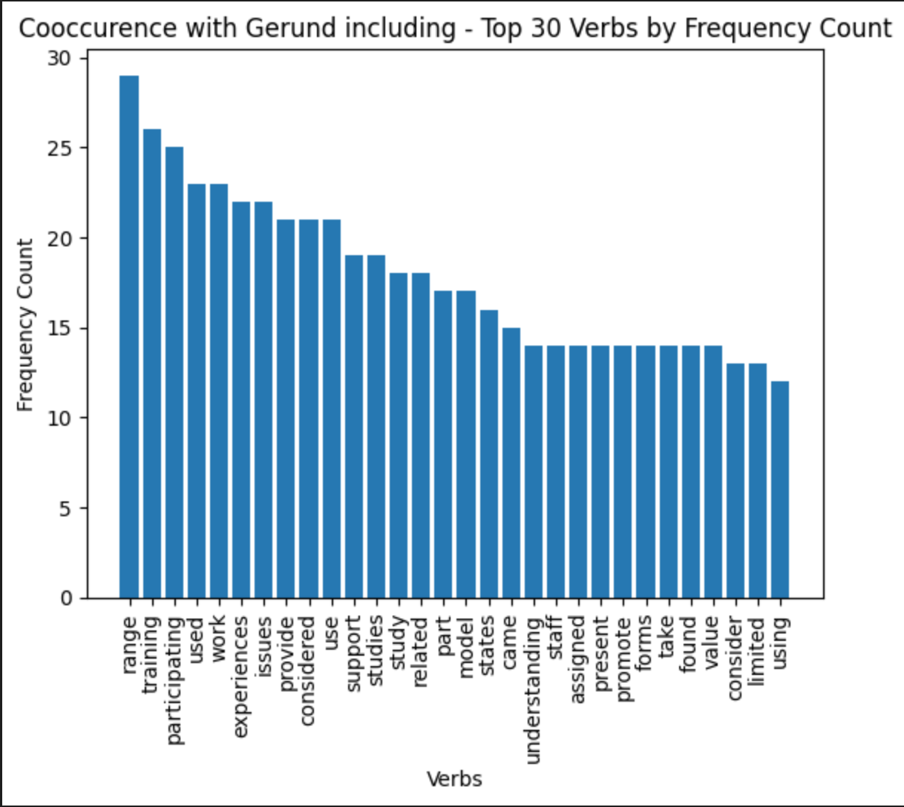
Methodology- Co-occurrence between gerunds and verbs
Repeated verb Co-occurences~1400
Unique verb Co-occurences~950
The verbs that appear more
frequently in the dataset should co-occur more with high impact Gerunds?

Slide 10
Methodology- Co-occurrence between gerunds and verbs
used, using, found, take, provide, related

Slide 11
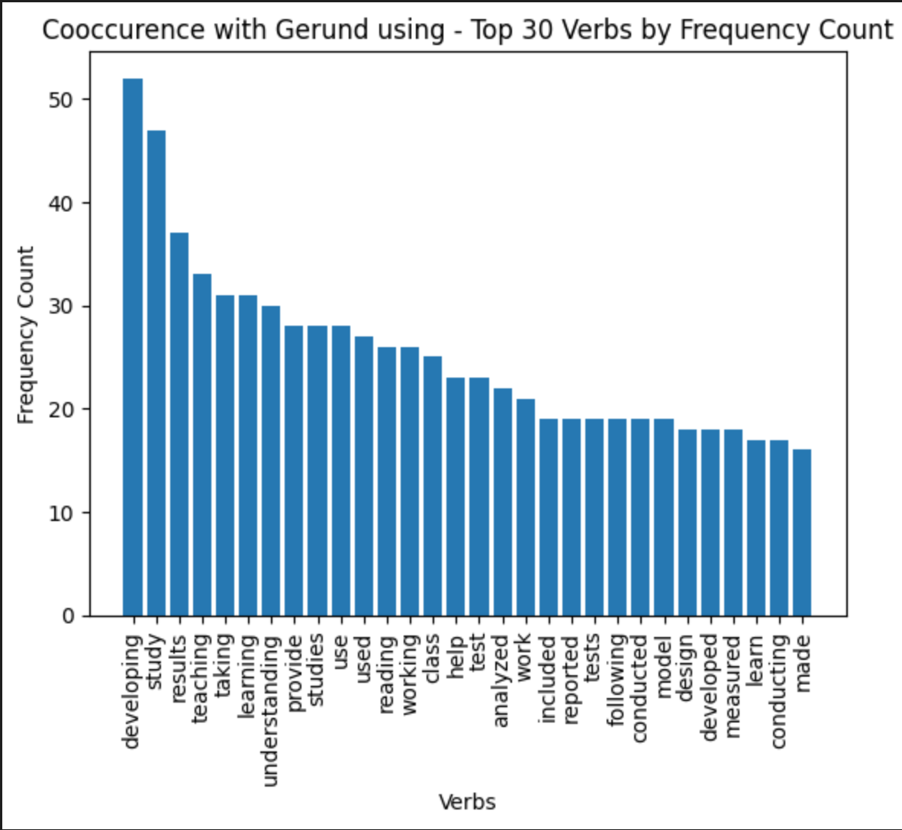
Methodology- Co-occurrence between gerunds and verbs
learning, developing, used, taking, provide

Slide 12
Methodology
Co-occurrence between gerunds and verbs
Co-occurrence between gerund types and verbs types (from verbnet)
Co-occurrence between gerund and verb types (from verbnet)
Co-occurrence between the position of verbs w.r.t gerund and verb types (from verbnet)

Slide 13
Methodology
Sentence
POS
Verbs (including gerunds)
Refined Verbs
Verbs class ids
Verbnet
Verbnet
Verbnet
Gerund Type
Co-occurrence
Parent Class
(verb-type)
Gerund
Co-occurrence

Slide 14
Methodology
Sentence: Growing up black in the 1950s, I never had the impression that whites were much disturbed by guilt
when it came to blacks.
IF token.pos == VERB
Verbs: Growing, had, disturbed, came
IF Vnclass = verbnet.classids (lemma = TOKEN.lemma_):
IF Vnclass:
Refined Verbs: Growing, disturbed, came
Verb Class ids: set([['appear-48.1.1', 'build-26.1', 'calibratable_cos-45.6-1', 'entity_specific_modes_being-47.2’,
'grow-26.2', 'other_cos-45.4'], ['amuse-31.1'], ['appear-48.1.1', 'escape-51.1-2’]])
(Majority Voting or the first term) Mapping to parent dictionary
Parent Verb: ['Verbs of Appearance, Disappearance, and Occurrence', 'Psych-Verbs’,
'Verbs of Appearance, Disappearance, and Occurrence']

Slide 15
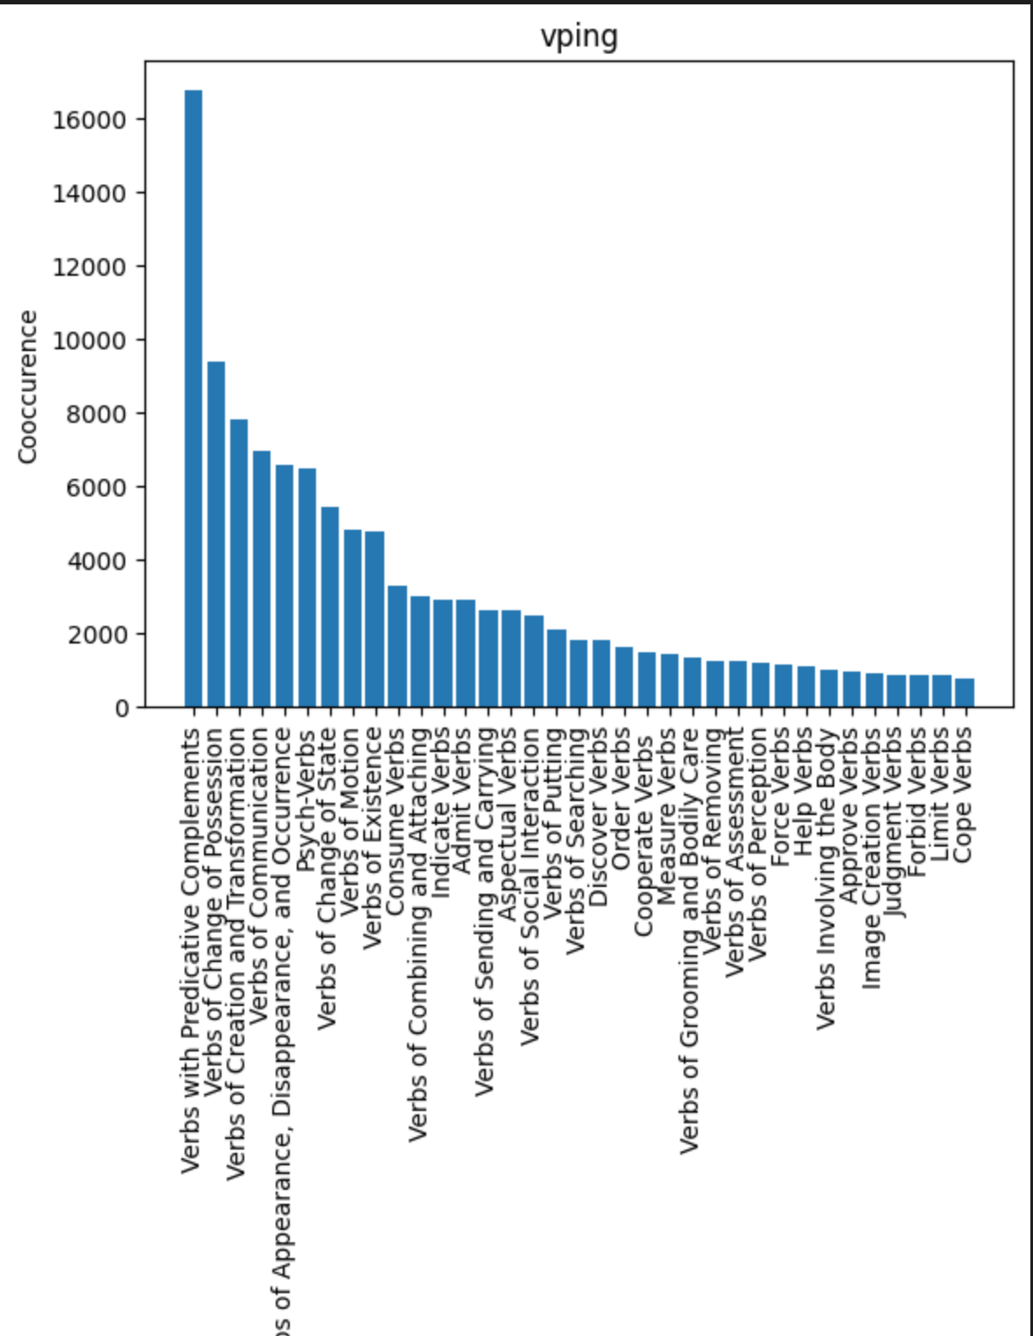
Methodology

Slide 16
Methodology
Verbs of predicative complements
seem: He seems tired.
become: The sky became dark.
feel: The water feels cold.
Verbs of change of possession
Verbs that indicate a change of possession are known as transfer verbs. These are verbs that show the
movement of something from one person or entity to another.
give: She gave me a present.
take: He took my phone.
Verbs of appearance, disappearance, and occurrence are known as intransitive verbs because they do not
require a direct object.
appear: The sun appeared from behind the clouds.
disappear: The bird disappeared into the trees.
arrive: The train arrived at the station.
depart: The plane departed from the airport.

Slide 17
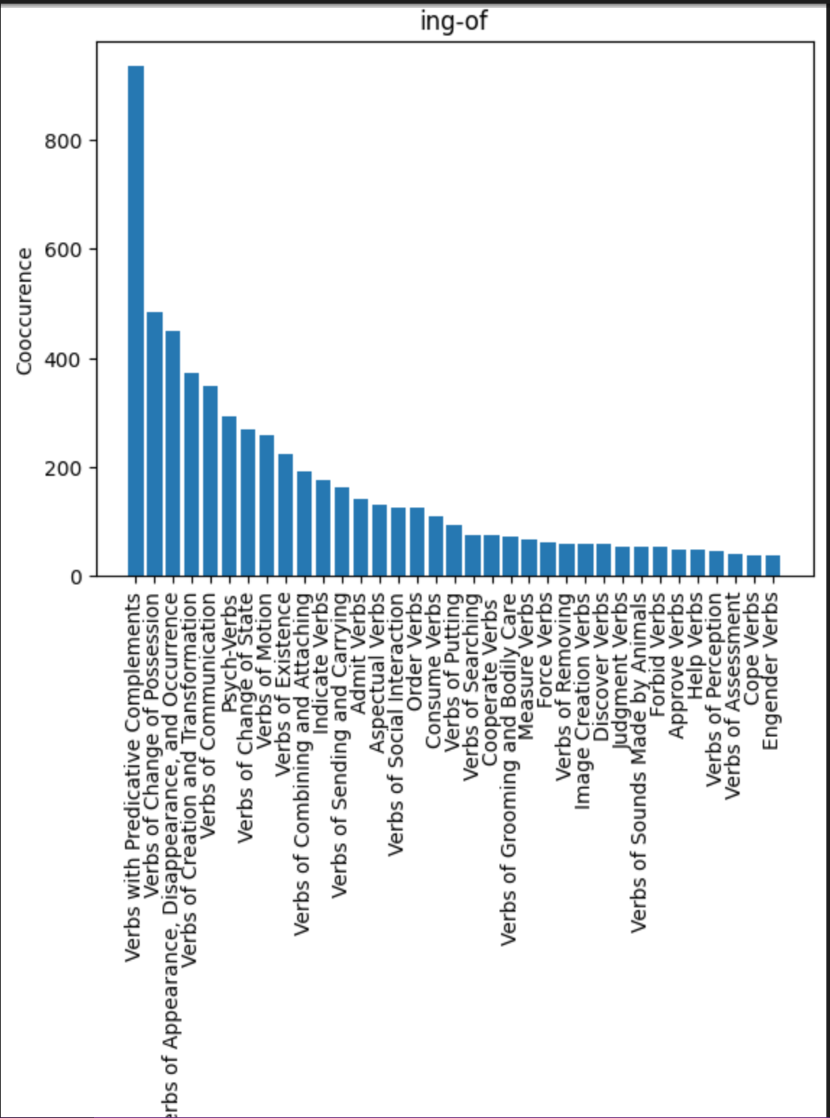
Methodology

Slide 18
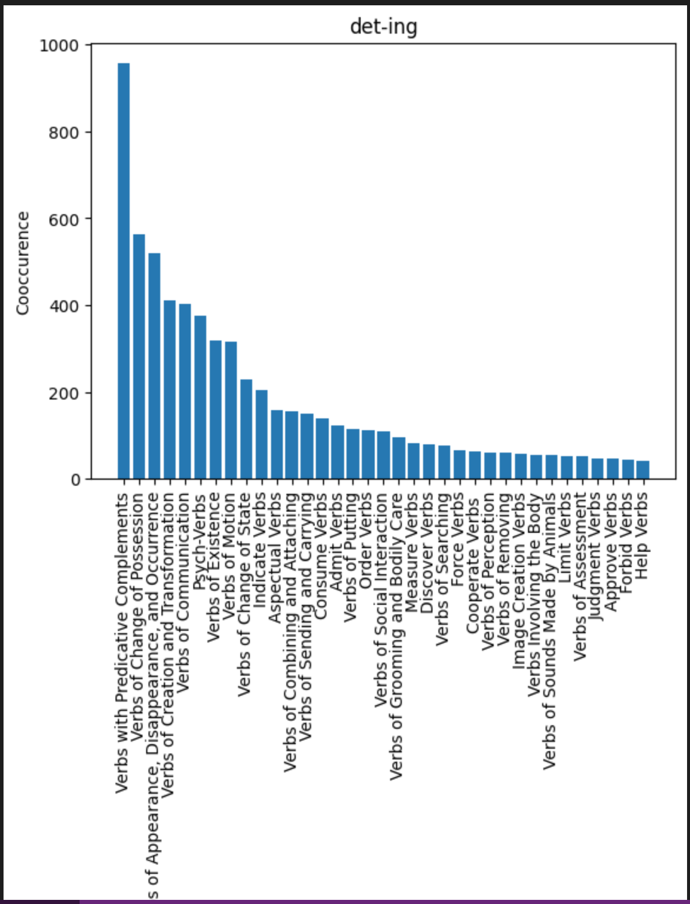
Methodology

Slide 19
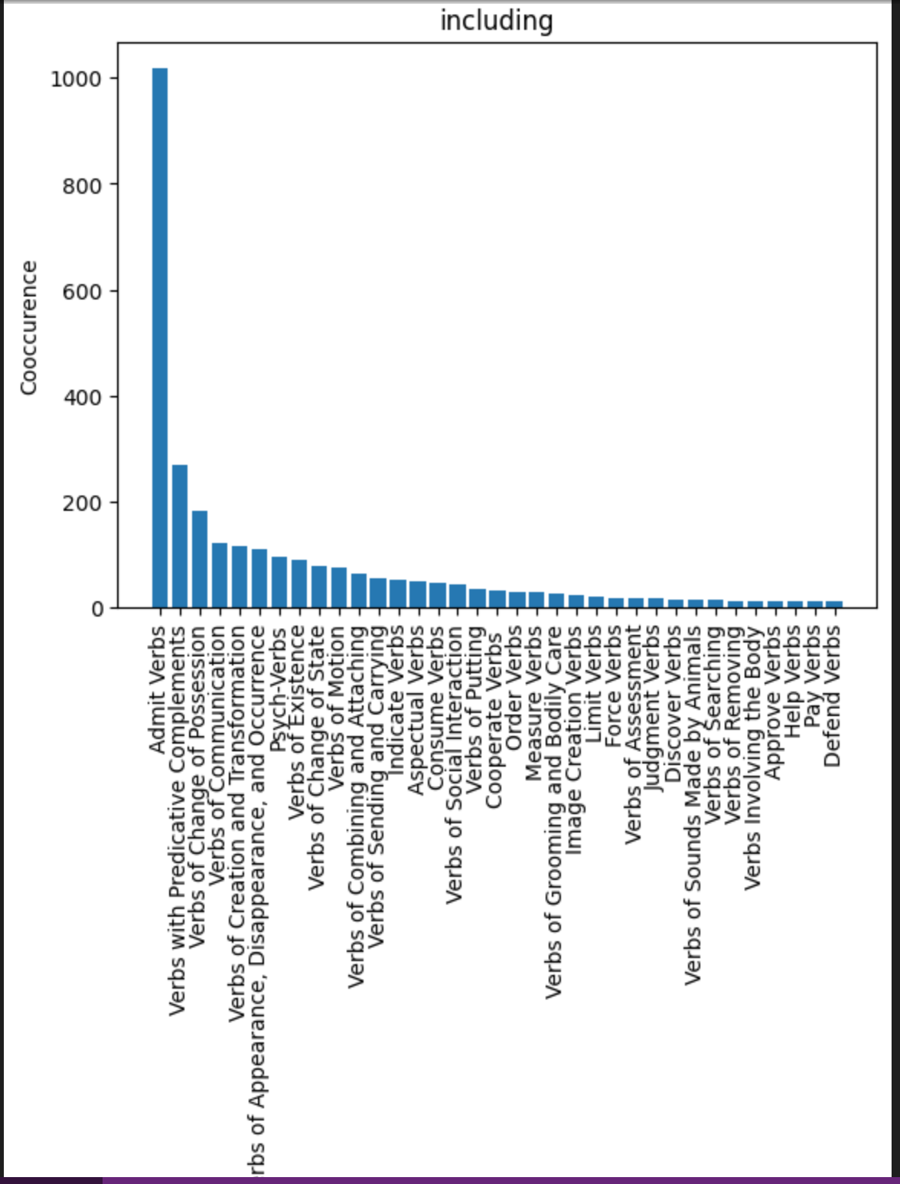
Methodology

Slide 20
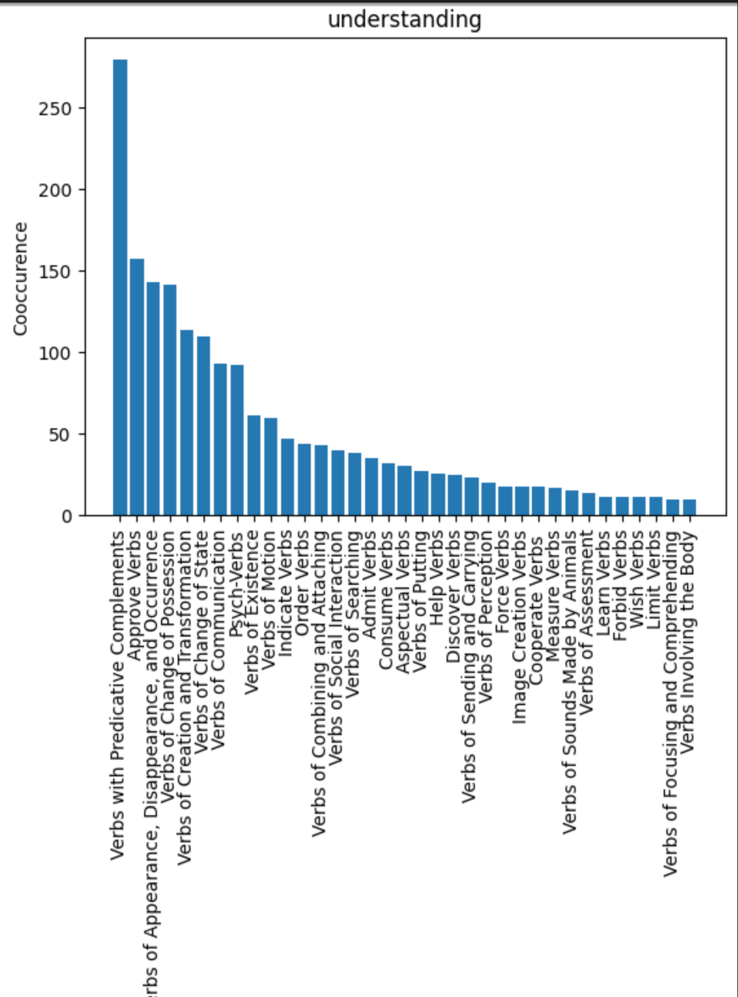
Methodology

Slide 21
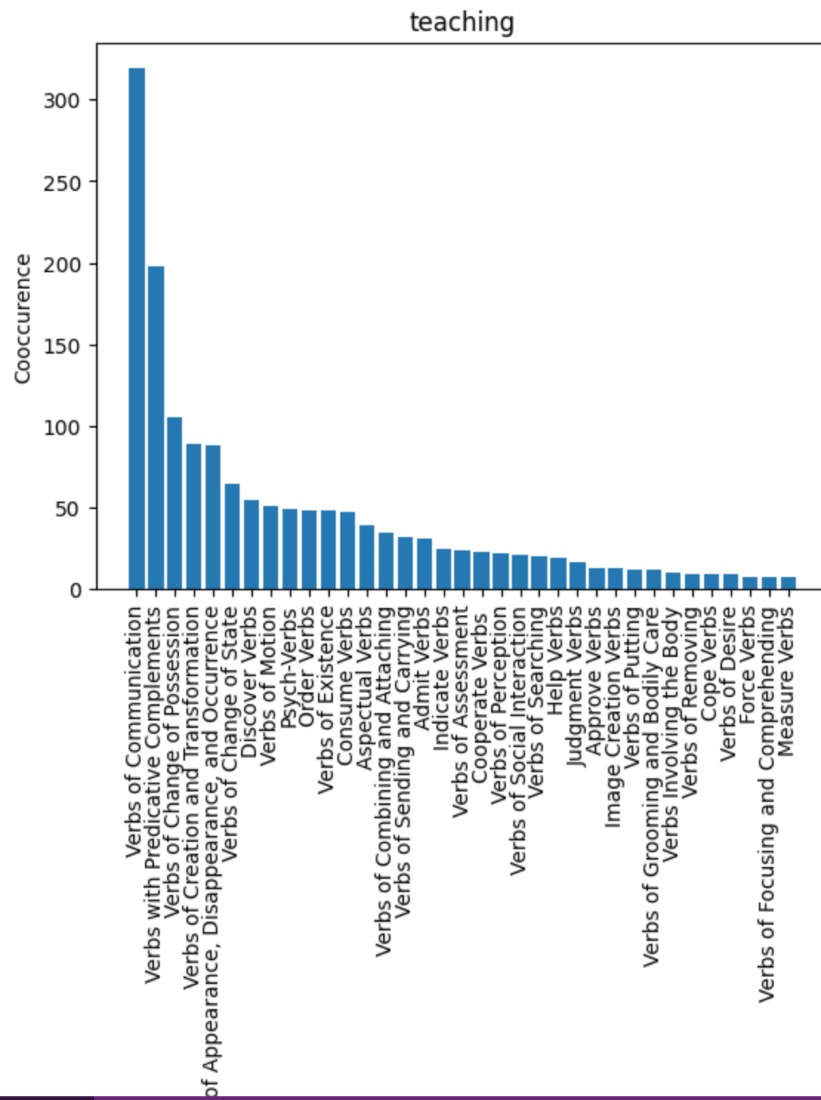
Methodology

Slide 22
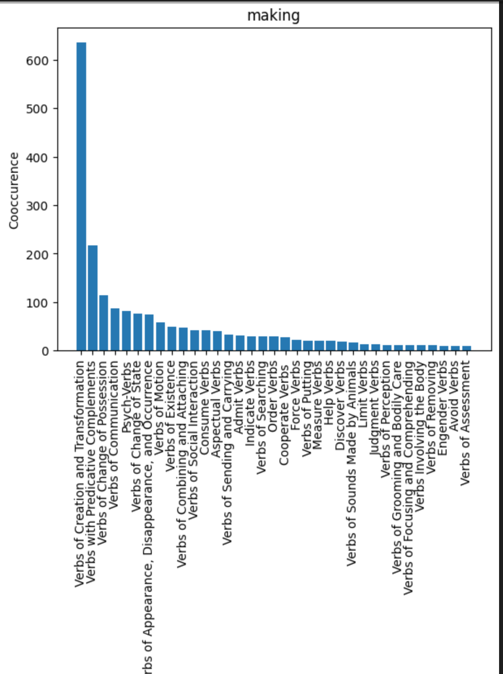
Methodology

Slide 23
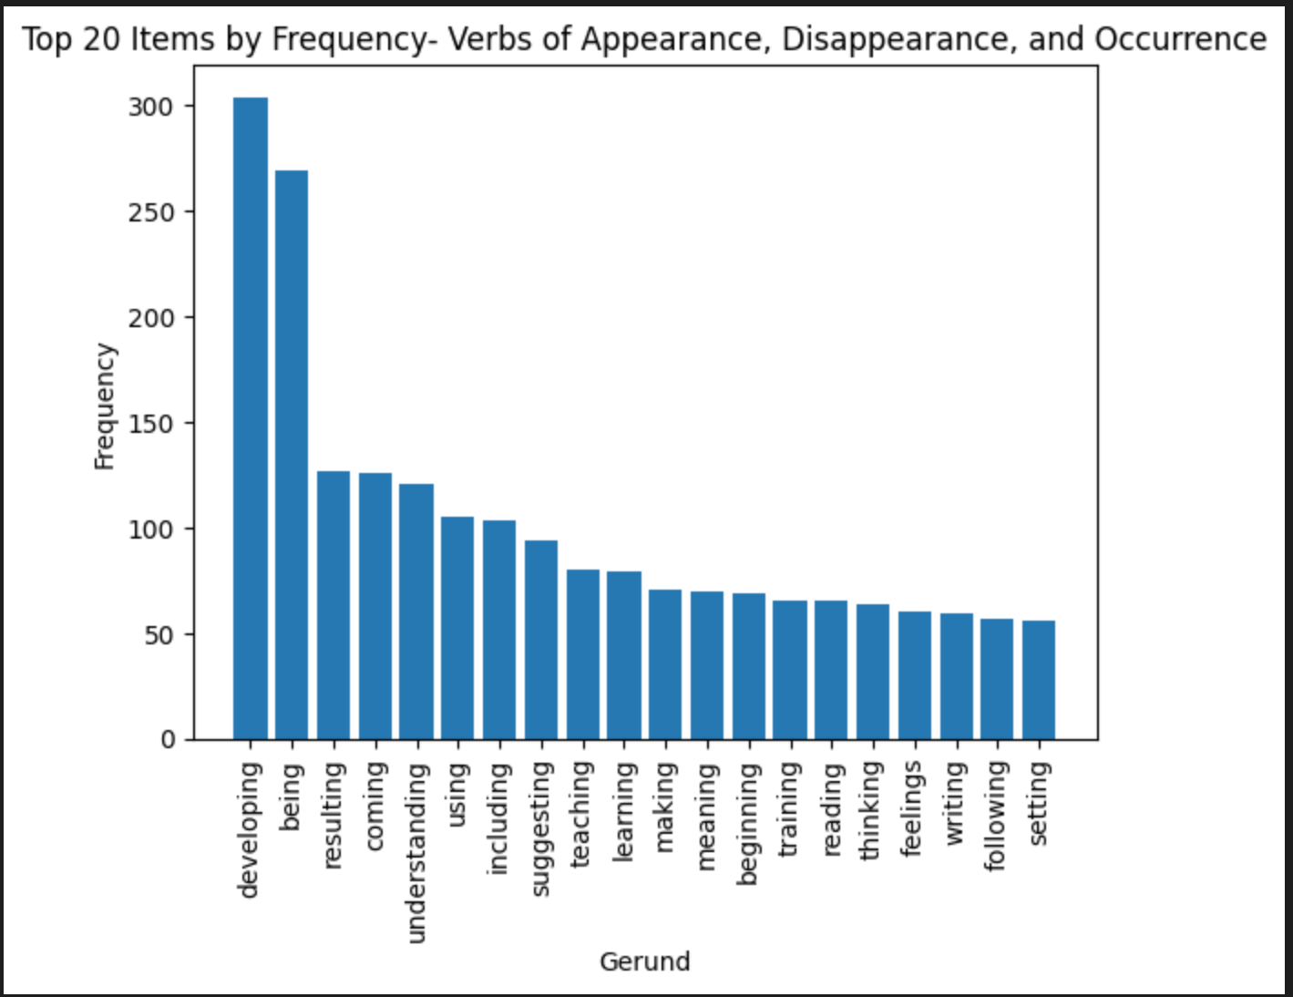
Methodology

Slide 24
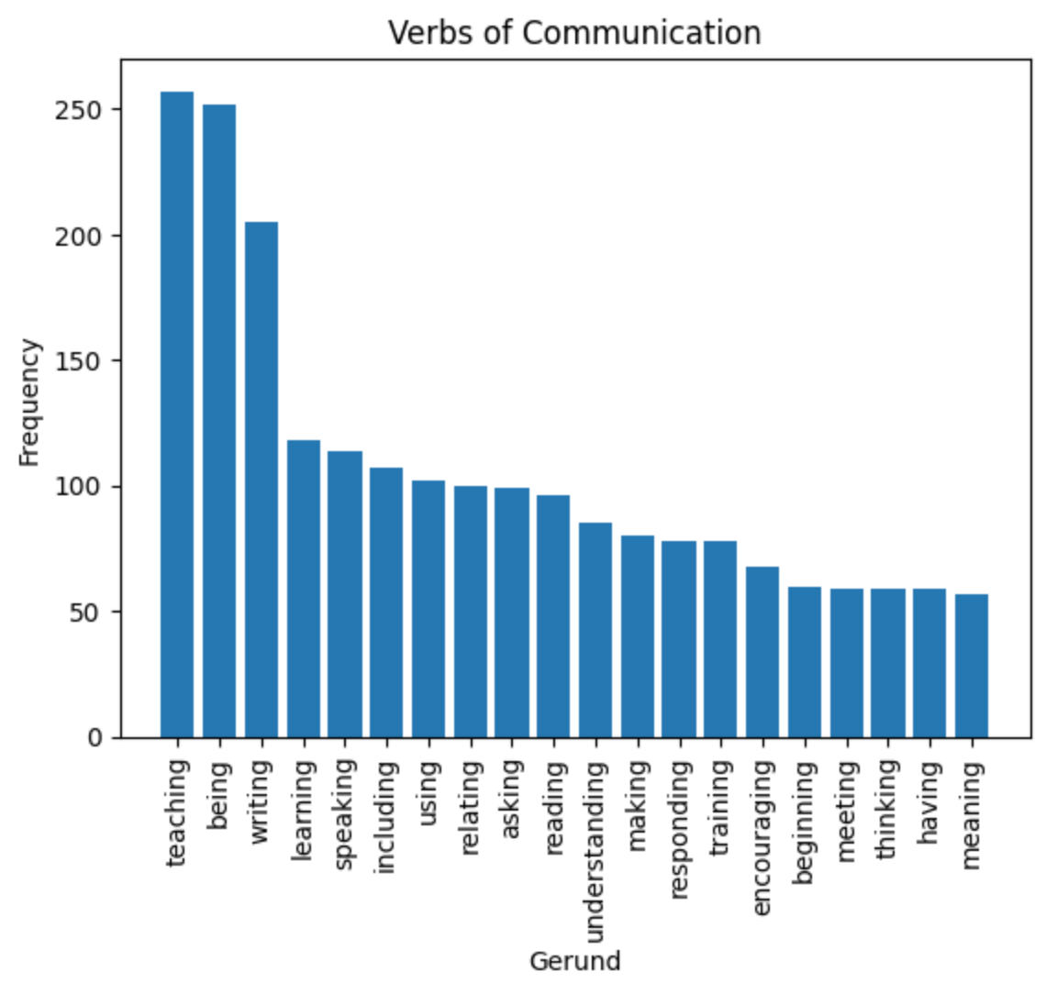
Methodology

Slide 25
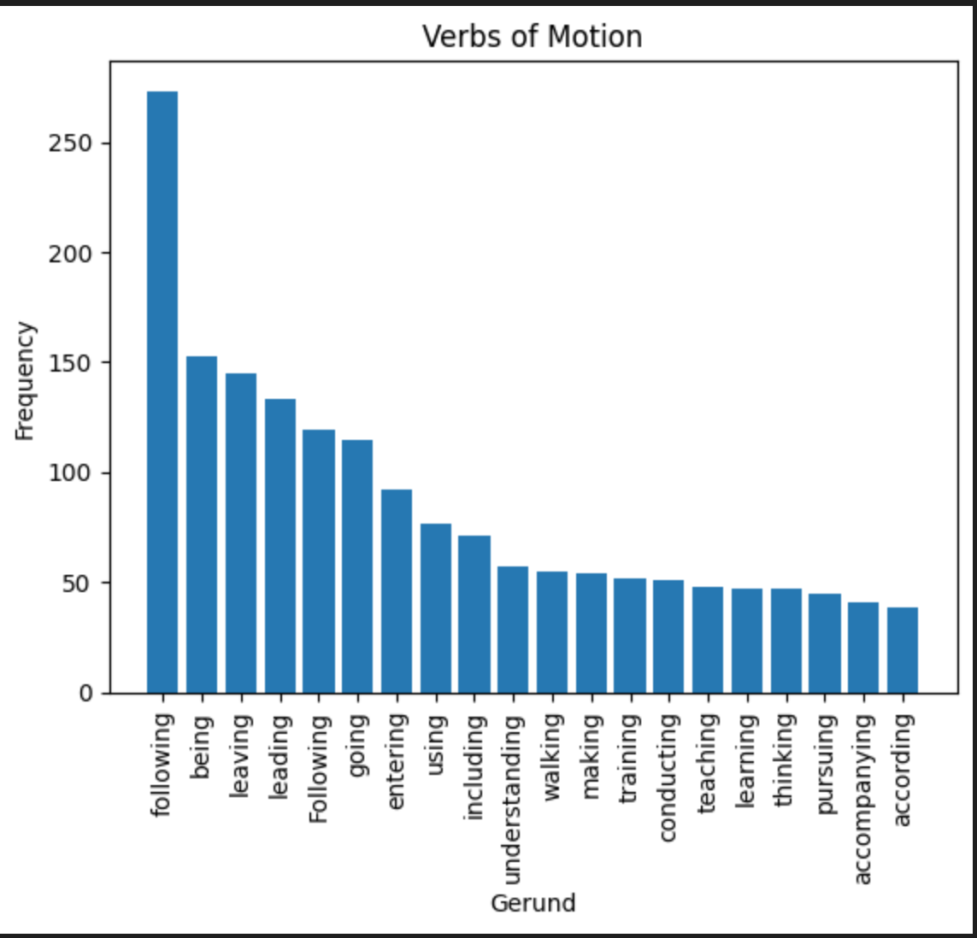
Methodology

Slide 26
Methodology
Co-occurrence between gerunds and verbs
Co-occurrence between gerund types and verbs types (from verbnet)
Co-occurrence between gerund and verb types (from verbnet)
Co-occurrence between the position of verbs w.r.t gerund and verb types (from verbnet)

Slide 27
Methodology
Sentence
POS
Verbs (including gerunds)
Refined Verbs
Verbs class ids
Verbnet
Verbnet
Gerund Type
Before Gerund
Parent Class
(verb-type)
Gerund Position
On Gerund
Parent Class
(verb-type)
Gerund
After Gerund
Parent Class
(verb-type)

Slide 28
Methodology
Sentence: Growing up black in the 1950s, I never had the impression that whites were much disturbed by guilt
when it came to blacks.
Refined Verbs: Growing, disturbed, came
Verb Class ids: set([['appear-48.1.1', 'build-26.1', 'calibratable_cos-45.6-1', 'entity_specific_modes_being-47.2’,
'grow-26.2', 'other_cos-45.4'], ['amuse-31.1'], ['appear-48.1.1', 'escape-51.1-2’]])
(Majority Voting or the first term) Mapping to parent dictionary
Parent Verb: ['Verbs of Appearance, Disappearance, and Occurrence', 'Psych-Verbs’,
'Verbs of Appearance, Disappearance, and Occurrence’]
Gerund Position: [1] [Growing]
Before Gerund Position: []
On Gerund Position: ['Verbs of Appearance, Disappearance, and Occurrence’]
After Gerund Position: ['Psych-Verbs’, 'Verbs of Appearance, Disappearance, and Occurrence’]

Slide 29
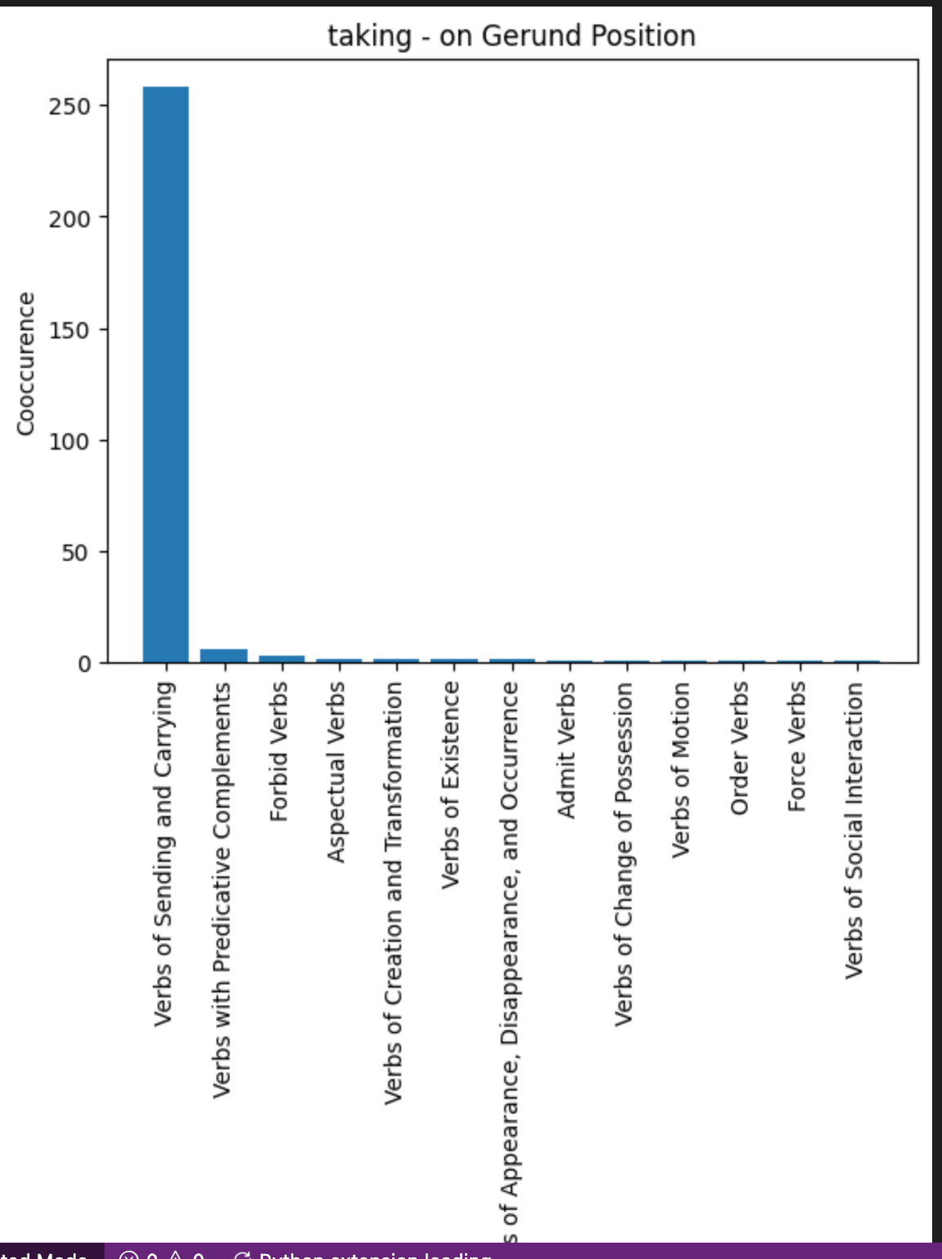
Methodology

Slide 30
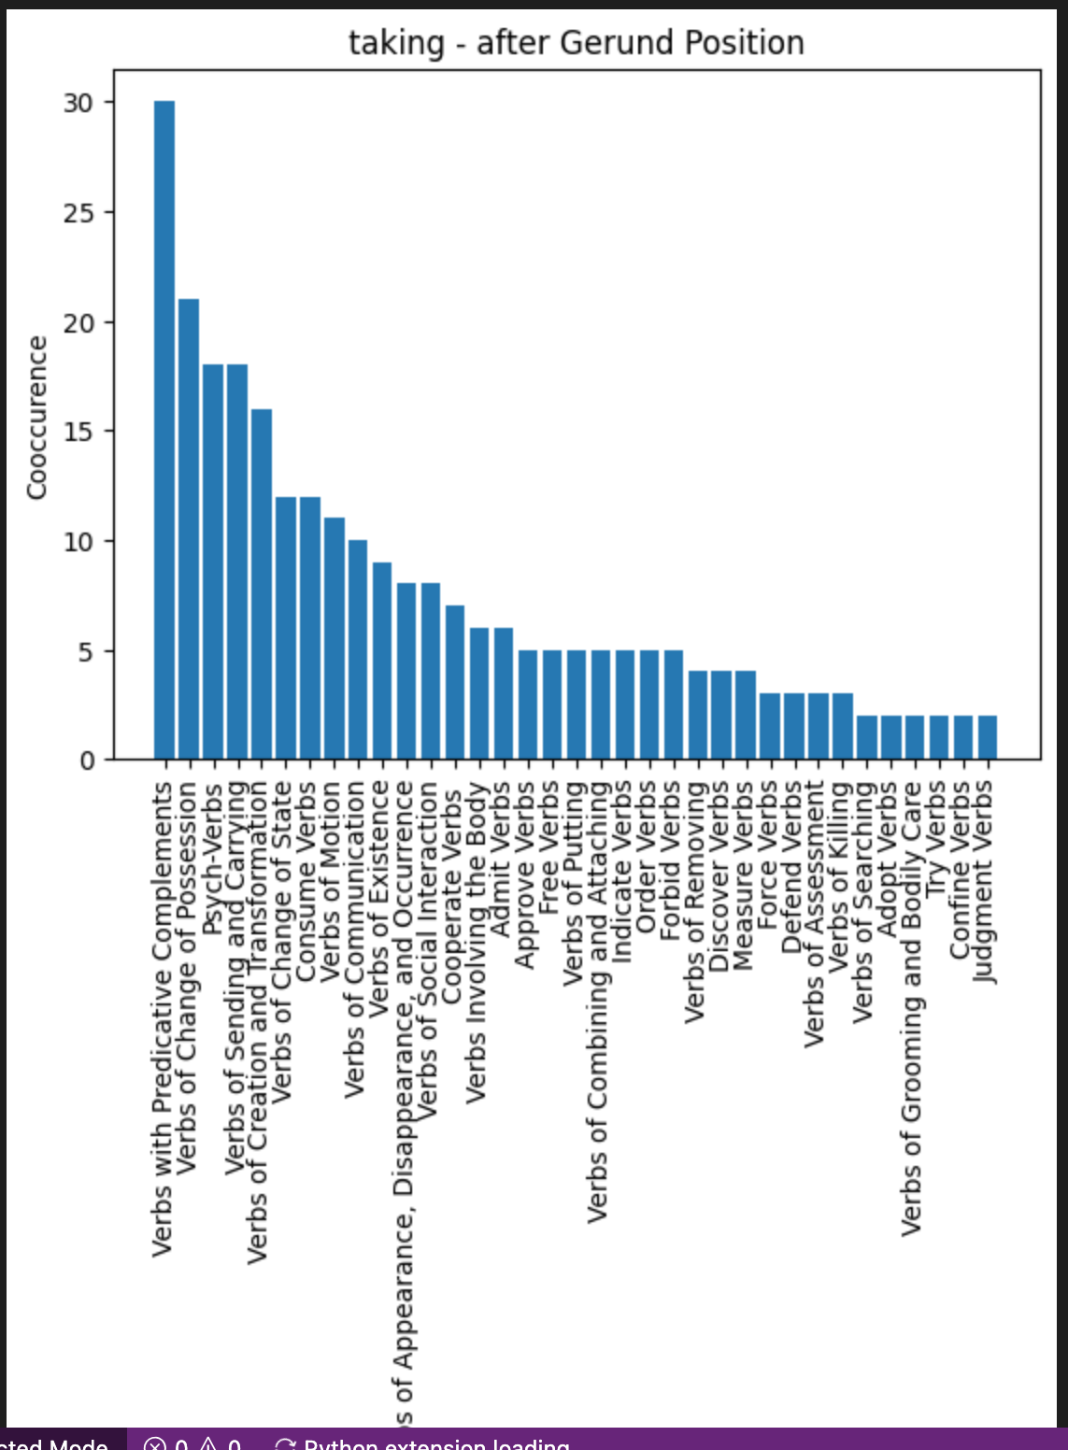
Methodology

Slide 31
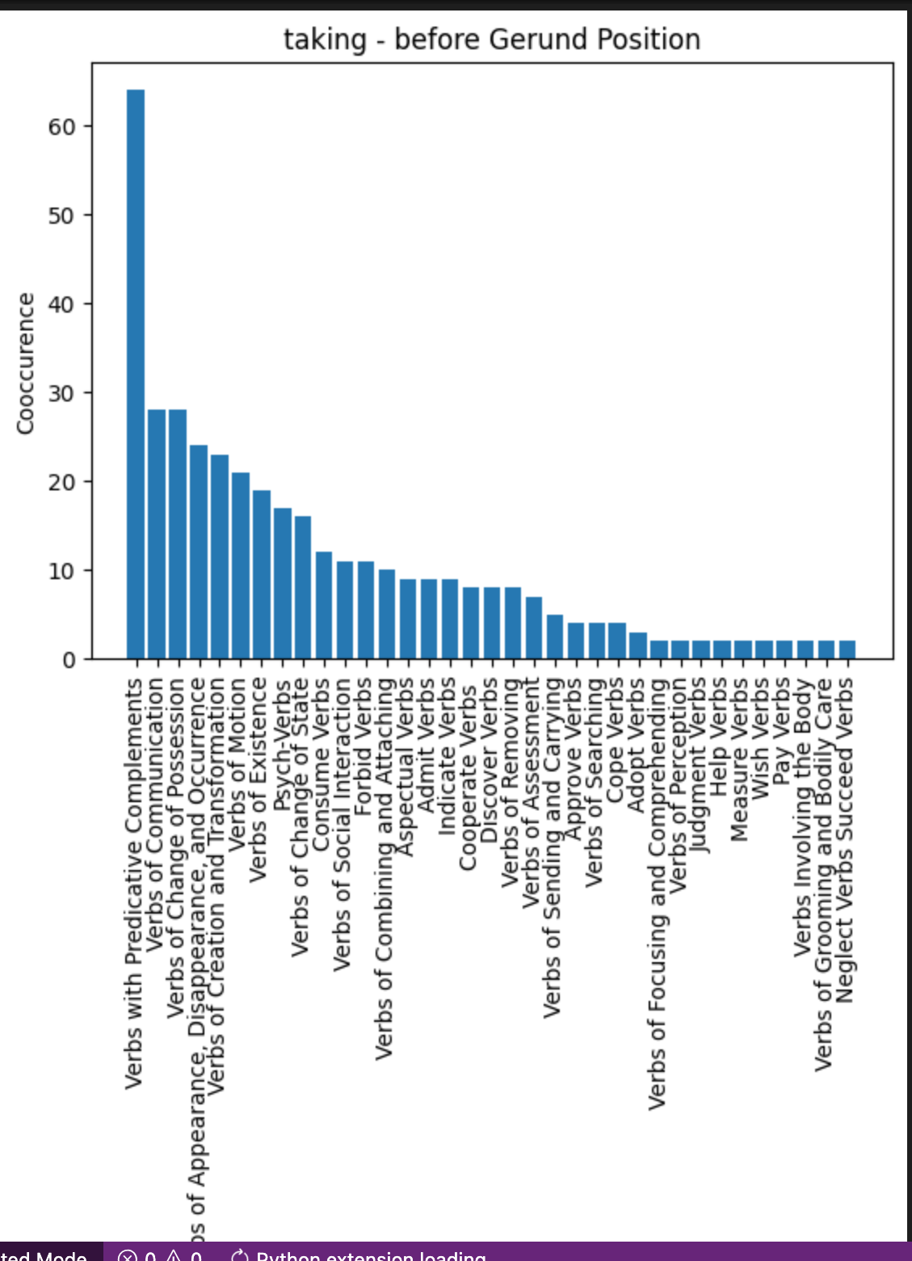
Methodology

Slide 32
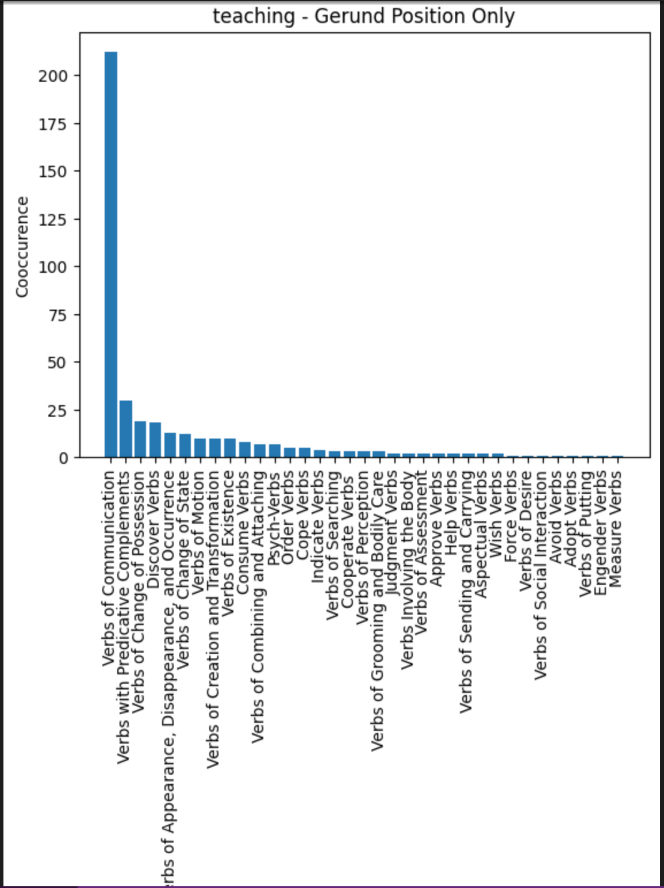
Methodology

Slide 33
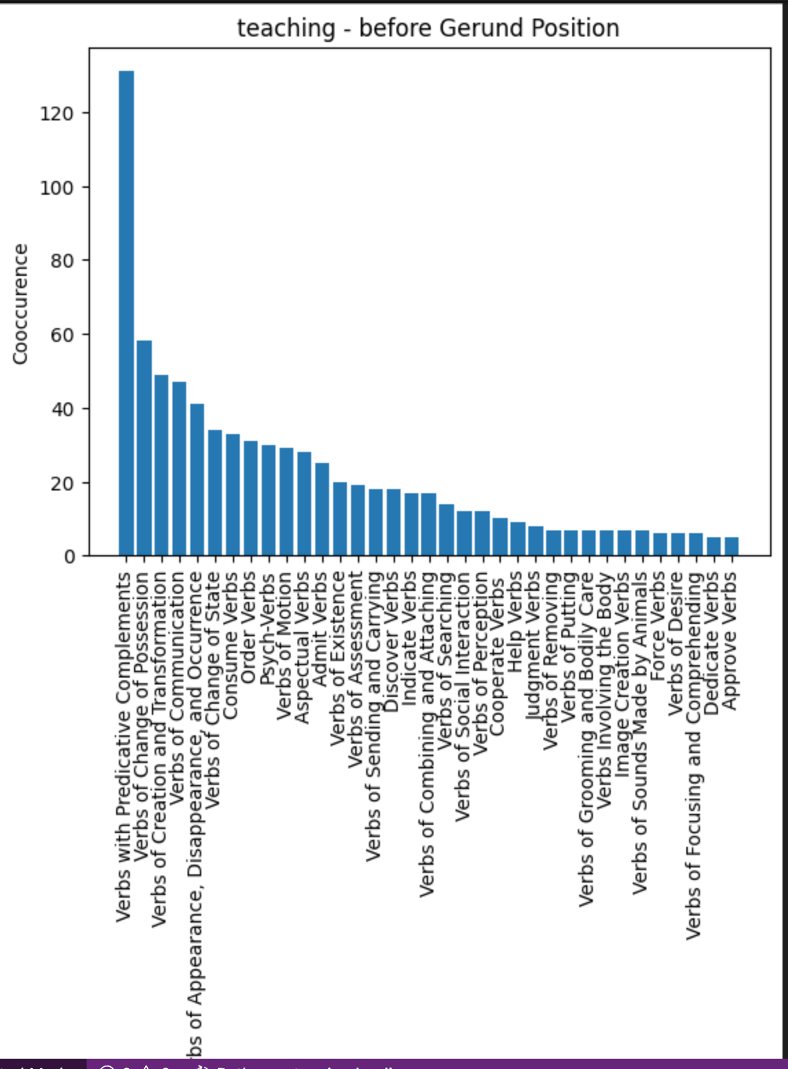
Methodology

Slide 34
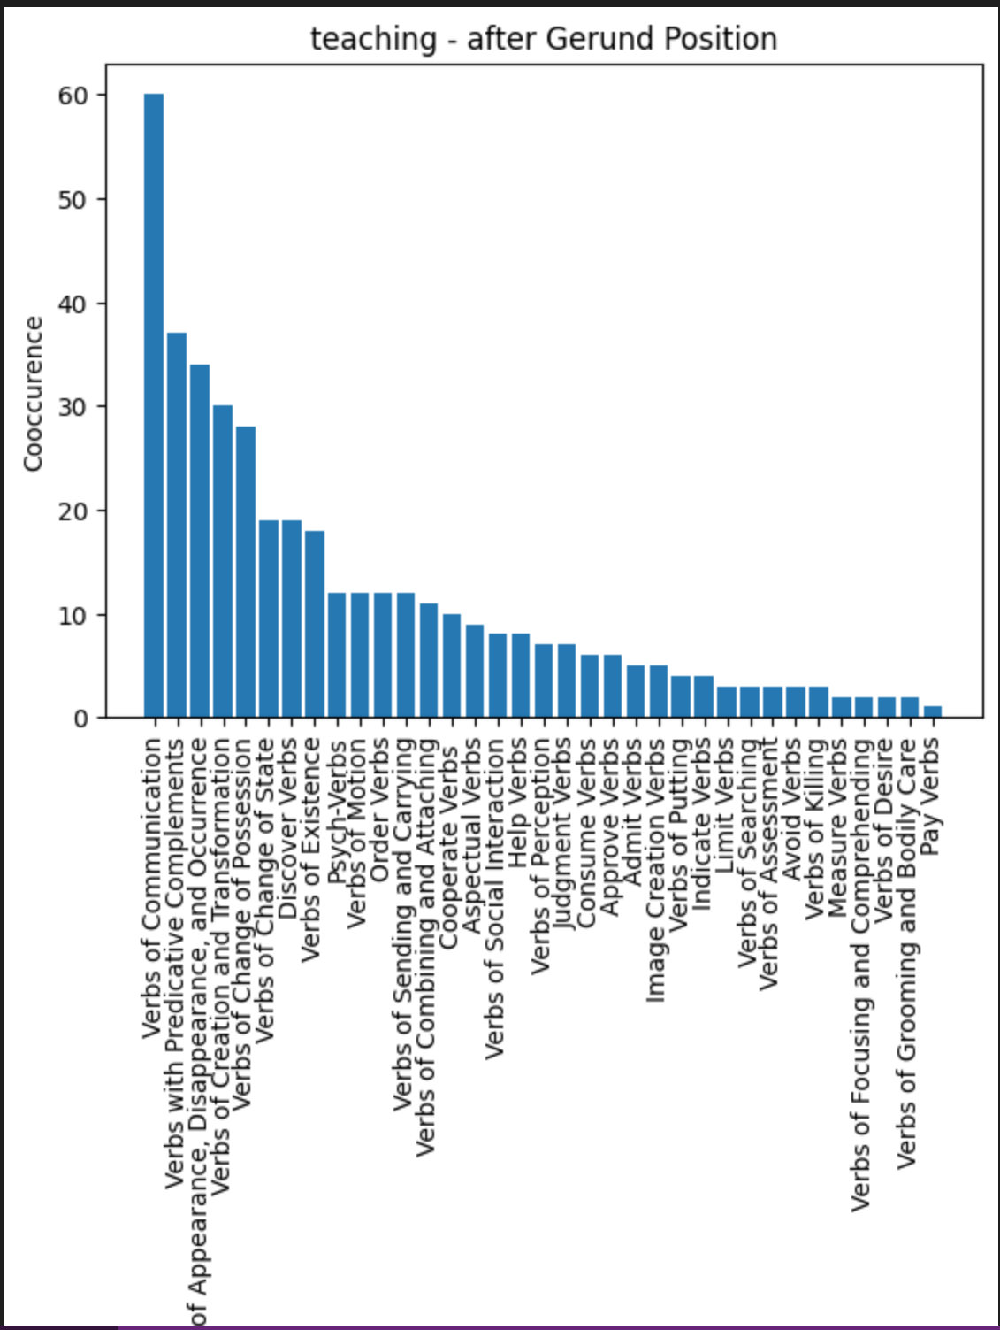
Methodology

Slide 35
Thank You

